Slide 1
Topics: Advanced Uses of Pointers, Chapter 17
Dynamic Storage Allocation
Memory Allocation Functions
Dynamically Allocated Arrays and Strings
Deallocating Storage
Next class:
Linked List

Slide 2
Uses of Pointers
Using a pointer to a variable as a function argument
Process arrays by performing arithmetic on pointers to array elements
Dynamic memory allocation
Pointers to functions

Slide 3
A Program’s Memory Layout
Types of memory and purpose
Stack
Local variables
Heap
Dynamically allocated memory
Static Data
Global (external) variables
Code
Program instructions

Slide 4
Dynamic Storage Allocation
Data structures such as arrays are normally fixed in size.
Fixed-size data structures can be a problem, since we’re forced to choose their sizes when writing a program.
With fixed-size data structures, memory needs are determined before program execution.
There may be cases where the memory needs of a data structure can only be determined during run time.

Slide 5
Dynamic Storage Allocation
Fortunately, C supports dynamic storage allocation: the allocation of memory storage during program execution.
Using dynamic storage allocation, we can design data structures that grow (and shrink) as needed.
Dynamic memory allocation functions such as malloc
C++ and Java use new operator

Slide 6
Memory Allocation in C programs
Automatic allocation
When you declare an automatic variable, such as a function argument or a local variable. Space is allocated when the compound statement (such as a function) containing the declaration is entered, and is freed when that compound statement is exited.
Dynamic allocation
Needed when the amount of memory you need depends on factors that are not known before the program runs; done by calling a memory allocation function.

Slide 7
Memory Allocation Functions
The <stdlib.h> header declares three memory allocation functions:
malloc—Allocates a block of memory but doesn’t initialize it.
calloc—Allocates a block of memory and clears it.
realloc—Resizes a previously allocated block of memory.
These functions return a value of type void * (a “generic” pointer).

Slide 8
Using malloc to Allocate Memory
Prototype for the malloc function:
void *malloc(size_t size);
malloc allocates a block of size bytes and returns a pointer to it.
//10000 bytes of memory allocated
p = malloc(10000);
size_t is an unsigned integer type defined in the library.
8

Slide 9
Using malloc to Allocate Memory
malloc and the other memory allocation functions obtain memory blocks from a storage pool known as the heap.
Calling these functions too often—or asking them for large blocks of memory—can exhaust the heap, causing the functions to return a null pointer.
9

Slide 10
Null Pointers
In C, pointers are variables that store addresses and can be NULL
Address 0
An invalid address
NULL is a macro (defined in various library headers) that represents the null pointer.

Slide 11
Null Pointers
If a memory allocation function can’t locate a memory block of the requested size, it returns a null pointer: NULL .
A null pointer is a special value that can be distinguished from all valid pointers.
After we’ve stored the function’s return value in a pointer variable, we must test to see if it’s a null pointer.

Slide 12
Null Pointers
An example of testing malloc’s return value:
p = malloc(10000);
if (p == NULL) {
/* allocation failed; take appropriate action */
printf("Error: malloc failed");
}

Slide 13
Dynamically Allocated Arrays and Strings

Slide 14
The sizeof Operator
The value of the expression
sizeof ( type-name )
is an unsigned integer representing the number of bytes required to store a value belonging to type-name.
sizeof(char) is always 1, but the sizes of the other types may vary.
sizeof(int) is normally 4.

Slide 15
The sizeof Operator
sizeof() tells you the size of variables and types, in bytes.
Size of the various types is implementation dependent.
Complier writers make the choice, considering hardware

Slide 16
Dynamically Allocated Arrays
Dynamic storage allocation is used most often for strings, arrays, and structures.
Dynamically allocated structures can be linked together to form lists, trees, and other data structures.
The close relationship between arrays and pointers makes a dynamically allocated array as easy to use as an ordinary array.
16

Slide 17
Using malloc to Allocate Storage for an Array
Suppose a program needs an array of n integers, where n is computed during program execution.
We’ll first declare a pointer variable:
int *a;
Once the value of n is known, the program can call malloc to allocate space for the array:
a = malloc(n * sizeof(int));
Always use the sizeof operator to calculate the amount of space required for each element.
17

Slide 18
Using malloc to Allocate Storage for an Array
We can now ignore the fact that a is a pointer and use it instead as an array name
For example, we could use the following loop to initialize the array that a points to:
for (i = 0; i < n; i++)
a[i] = 0;
We also have the option of using pointer arithmetic instead of subscripting to access the elements of the array.
18

Slide 19
Exercise
Which of the following correctly declares a dynamic array of integers of size n?
A) int a;
a = n * malloc(sizeof(int));
B) int a;
a = malloc(n * sizeof(int));
C) int *a;
a = malloc(n* sizeof(int));
D) int *a;
a = n * malloc(sizeof(int));
19
Notes:
Answer: C

Slide 20
Dynamically Allocated Strings
Dynamic storage allocation is often useful for working with strings.
Strings are stored in character arrays, and it can be hard to anticipate how long these arrays need to be.
By allocating strings dynamically, we can postpone the decision until the program is running.

Slide 21
Using malloc to Allocate Memory for a String
A call of malloc that allocates memory for a string of n characters:
p = malloc(n + 1);
p is a char * variable.
Each character requires one byte of memory; adding 1 to n leaves room for the null character.

Slide 22
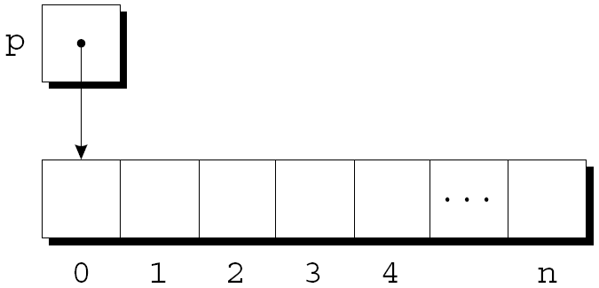
Using malloc to Allocate Memory for a String
Memory allocated using malloc isn’t cleared, so p will point to an uninitialized array of n + 1 characters:

Slide 23
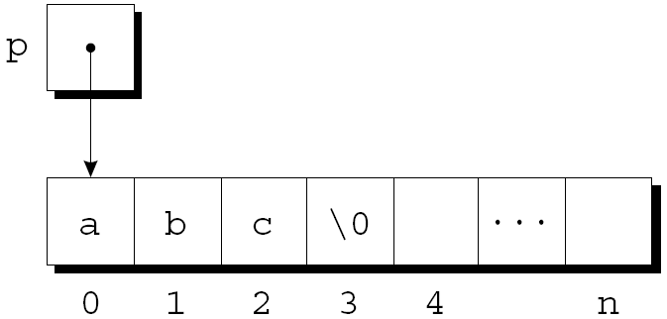
Using malloc to Allocate Memory for a String
Calling strcpy is one way to initialize this array:
strcpy(p, "abc");
The first four characters in the array will now be a, b, c, and \0:

Slide 24
Example: Read a sentence
Read a sentence from the keyboard
using a large input buffer.
Allocate memory to hold the sentence
just large enough to hold what was entered.
Copy the sentence into the dynamically allocated memory block.

Slide 25
Example
#include <stdio.h>
#include <stdlib.h>
#include <string.h>
#include <ctype.h>
int read_line(char str[], int n);
int main()
{
char input_buffer[1001];
int length = 0;
char *sentence = NULL;
printf ("Please type a sentence:\n");
read_line(input_buffer, 1000);

Slide 26
length = strlen(input_buffer);
printf ("Allocating %d bytes to hold the sentence\n\n", length+1);
sentence = malloc(length+1);
if(sentence == NULL){
printf("malloc failed");
return 1;
}
strcpy (sentence, input_buffer);
printf ("%s\n", sentence);
return 0;
}
int read_line(char str[], int n)
{
int ch, i = 0;
while ((ch = getchar()) != '\n') {
if (i < n)
str[i++] = ch;
}
str[i] = '\0';
return i;
}

Slide 27
Deallocating Storage

Slide 28
Deallocating Storage
A program may allocate blocks of memory and then lose track of them, thereby wasting space – if this happens too often – it can exhaust the heap, causing the functions to return a null pointer.
When a program is done with a piece of dynamically allocated memory, it should properly deallocate it.
28

Slide 29
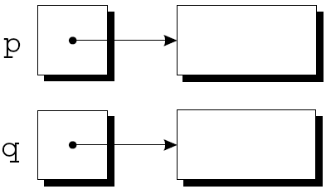
Losing Track of Memory
Example:
p = malloc(…);
q = malloc(…);
p = q;
A snapshot after the first two statements have been executed:
29

Slide 30
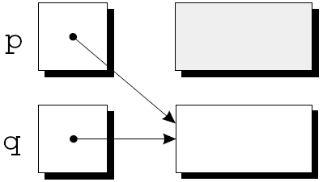
Losing Track of Memory
After q is assigned to p, both variables now point to the second memory block:
There are no pointers to the first block, so we’ll never be able to use it again.
30

Slide 31
Deallocating Storage
A block of memory that’s no longer accessible to a program is said to be garbage.
A program that leaves garbage behind has a memory leak.
Some languages provide a garbage collector that automatically locates and recycles garbage, but C doesn’t.
Instead, each C program is responsible for recycling its own garbage by calling the free function to release unneeded memory.
31

Slide 32
The free Function
Prototype for free:
void free(void *ptr);
free will be passed a pointer to an unneeded memory block:
p = malloc(…);
q = malloc(…);
free(p);
p = q;
Calling free releases the block of memory that p points to.
32

Slide 33
The “Dangling Pointer” Problem
free(p) deallocates the memory block that p points to, but doesn’t change p itself.
If we forget that p no longer points to a valid memory block, chaos may ensue:
char *p = malloc(4);
…
free(p);
…
strcpy(p, "abc"); /*** WRONG ***/
33

Slide 34
The “Dangling Pointer” Problem
Attempting to access or modifying the memory (has been freed) that p points to causes undefined behavior: this is called “Dangling Pointer” problem
char *p = malloc(4);
…
free(p);
…
strcpy(p, "abc"); /*** WRONG ***/
34

Slide 35
Programming Exercise
Modify the reading a sentence example (read_sentences.c on Canvas Files>Week 12>In-class Exercises) so that it reads in a series of sentences entered by the user and display them in sorted order.
Assume there are no more than 50 sentences.
Stop reading when the user enters an empty word (Hint: use length variable to determine whether a string is an empty word).

Slide 36
Exercise, Cont’d
Allocate memory for each sentence. Store all the sentences in an array of strings (provided as variable sentences).
After all the sentences have been read, print them in order after sorting them with qsort function (provided in the program).
Use free function to release the block of memory that were allocated to the sentences before the program terminates.

